Slide 1

US Mass Shootings Exploratory Analytics
Team Member Name: Sneha Godbole
Email id: snegodbo@umail.iu.edu

Slide 2
Agenda
Introduction / Motivation
Relevant Existing Work
Hypothesis and Research Questions
Dataset Details
Implementation Approach & Techniques
Data Preprocessing
Implementation Techniques Details Per Insight
Tools & Technologies
Results & Insights
Conclusions

Slide 3
Introduction / Motivation
The phenomenon of mass shootings has emerged in US over the past 50 years.
398 mass shootings : 1996 deaths and 2488 injured
Is this truth of Modern American History?
Interesting / Motivational Questions
Why would someone with no criminal background do that?
Since when and how the mass shootings rate have boosted?
What is the correlation of incident location and mass shootings?
Is there any correlation of Age, Sex, Race and Cause with Mass shooting incidents?
Mass shootings analysis and pattern over period of last few decades?

Slide 4
Relevant Existing Work
An interesting research paper and literature review named “Mental Illness, Mass Shootings, and the Politics of American Firearms” which gave me an aspiration is available @ https://www.ncbi.nlm.nih.gov/pmc/articles/PMC4318286/.
A research paper named "Multiple vantage points on the mental health effects of mass shootings”, available @ https://www.ncbi.nlm.nih.gov/pubmed/25085235 describes how mental health effects mass shootings.
These papers do analysis of mental illness, American firearms policies, the effects of shooting rampages on children and adolescents, the psychological effects for wounded victims and the emergency healthcare personnel who care for them, the disaster behavioral health considerations for preparedness and response, and the media "framing" of mass shooting incidents in relation to the portrayal of mental health themes
I also found the dataset and some interesting insights @ https://www.kaggle.com/zusmani/us-mass-shootings-last-50-years which is motivational for me to pick up this topic for my work.

Slide 5
Hypothesis and Research Questions
I believe the implementation would lead to interesting exploratory analysis and I will get some meaningful insights about the mass shootings in the US based on the dataset I have chosen.
My objective is that the implementation should lead to interesting exploratory analysis and I should get some meaningful insights from this mass shooting dataset.
Research Questions / Potential Insights targeted to be found out –
Distribution of mass shootings across all US states / areas.
Rate of mass shootings over time / #years.
How many people got killed and injured per year?
Is there any correlation between shooter and his/her Race, Gender?
What cities and states are more prone to such attacks?
…

Slide 6
Data Source Details
Potential Data Source
The dataset which is used for my work is available at https://www.kaggle.com/zusmani/us-mass-shootings-last-50-years .
I verified the datasets and it looks good to me in terms of metadata, data volume, quality, etc.
Data statistics
Mass shootings information data for last 50 years
~323 rows representing unique incidents, each described with 21 metadata columns.
Key fields: Location, Date, Area, Target, Cause, Summary, Suspect information, Victims information, etc.

Slide 7
Implementation Approach & Techniques
Data Preprocessing Steps
As a requirement of doing exploratory analytics by year / month / date level, I standardized all the timestamp values in the given dataset. This was achieved by implementing a custom function and using it on entire dataset.
I used step #1 to populate one extra columns namely “year” for each row in a given dataset.
Result of steps #1 and #2 was stored in the form of DataFrame and was used for all further analytics / insights exploration
I did cleansing and standardization of the Race,Gender and Location columns, to implement the exploratory analysis for some use cases.

Slide 8
Implementation Approach / Methods
Number of Fatalities vs Injuries per Year
Analysis and visualization of fatalities vs injuries over all the years preset in the dataset.
Implementation Approach
I analyzed the dataset, aggregated #fatalities and #injuries for all the years available in the dataset and plotted this insight using a multi bar chart for all the years. This shows an insight on how the shootings have impacted on deaths and injuries.
Total victims per year
Analysis and visualization of total victims per year, for all the years preset in the dataset.
Implementation Approach
I analyzed the dataset, aggregated #Total victims of all the attacks for all the years present in the dataset and visualized the insight using scatterplot.

Slide 9
Implementation Approach / Methods
No of attacks by races
Analysis and visualization of number of attacks by races, for all the years preset in the dataset.
Implementation Approach
I analyzed the dataset and calculated the count of number of attacks by #Races for all the years present in the dataset and visualized the insight using simple Bar Chart.
Number of attacks per year
Analysis and visualization of number of attacks per year, for all the years preset in the dataset.
Implementation Approach
I have created new column in the DataFrame called “year” from original “Date” column so that I can easily count the number of attacks per year values. I have and visualized the insight using simple Line Chart.

Slide 10
Implementation Approach / Methods
Causes of Attacks
Analysis and visualization of different causes behind the attack, for all the years preset in the dataset.
Implementation Approach
I have calculated causes of attack by grouping the attacks by “Cause”. I have and visualized the insight using simple Bar Chart.
Overall No. of Attacks per Weekdays
Analysis and visualization of attacks happened over weekends vs weekdays, for all the years preset in the dataset.
Implementation Approach
From the “Date” column from dataset, I have calculated the number of attacks over the weekend by using pandas DateTime property “DayofWeek”.
For example:
weekday = date.dt.dayofweek / 5 == 1.
I have and visualized the insight using Pie Chart.

Slide 11
Implementation Approach / Methods
Tools & Technologies
I used following tools and technologies for the implementation –
Python
Panda Libraries
MatplotLib
Jupyter Notebook
Plotply
Numpy
Seaborn

Slide 12
Results & Insights

Slide 13
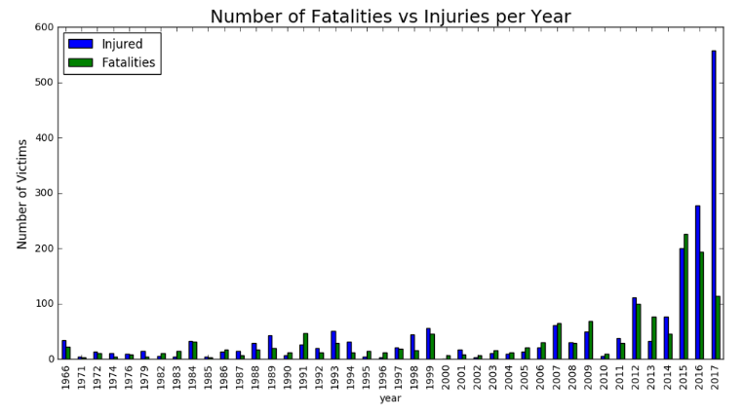
Number of Fatalities vs Injuries per Year
Highest Injuries :
558 Injuries in 2017
Highest Fatalities : 226 Deaths in 2015

Slide 14
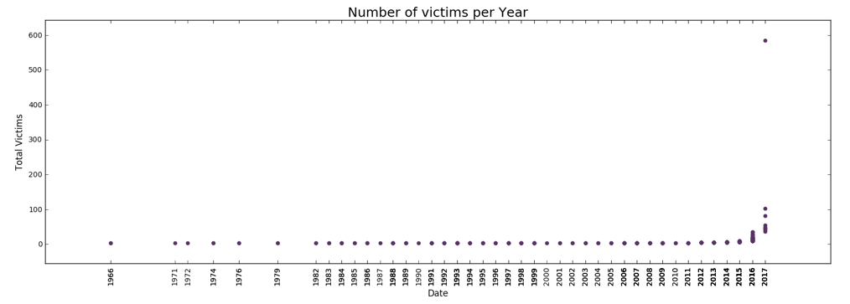
Number of Victims per Year
The rate has increased drastically 2016 onwards !

Slide 15
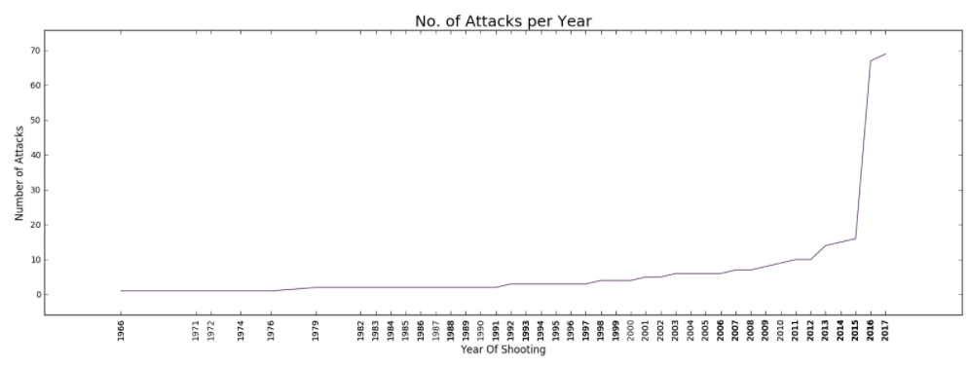
Number of Attacks per Year
The rate has increased drastically 2015 onwards, close to 4 times increase in 2016 !

Slide 16
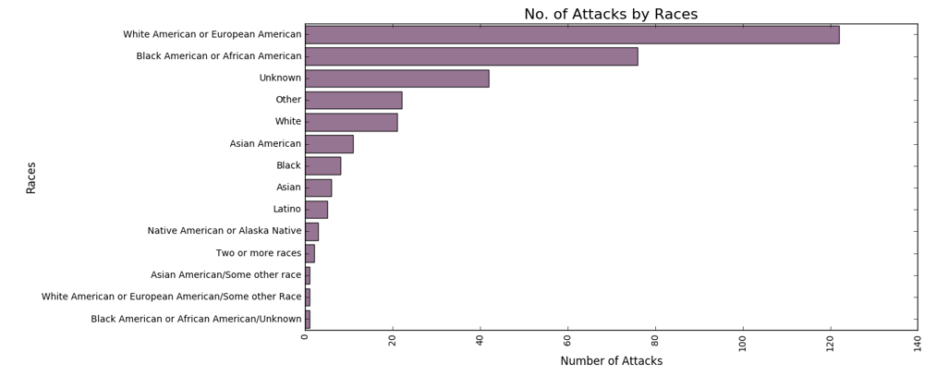
Number of Attacks by Races
Most attacks were by White or European Americans!

Slide 17
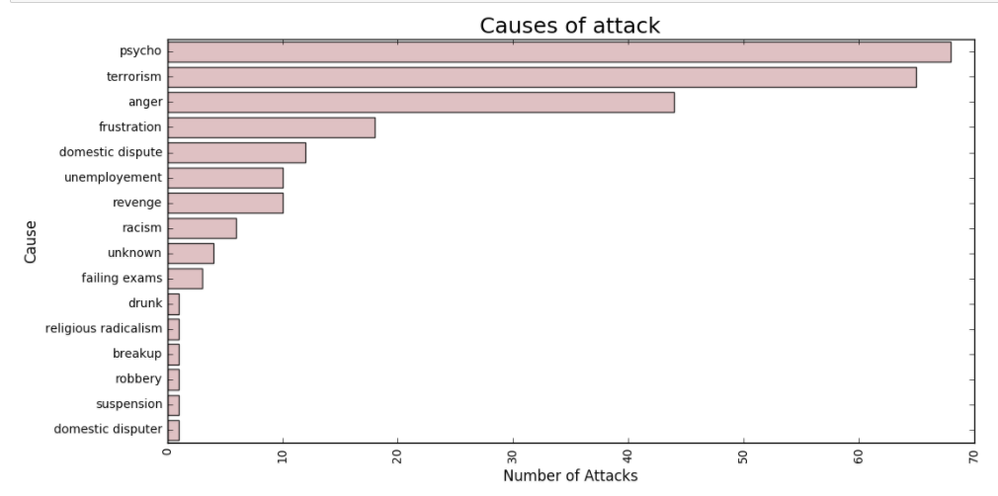
Causes of Attacks
Frustration, Anger, Psyco causes are way more than Terrorism!
We need to fix Mental Illness issue to reduce number of Attacks in US!

Slide 18
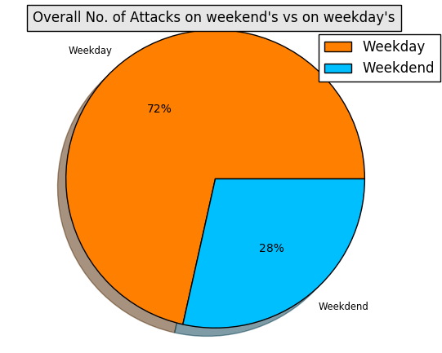
Overall #Attacks on Weekdays / Weekends
Weekday attacks are 2.5 times higher than Weekends!

Slide 19
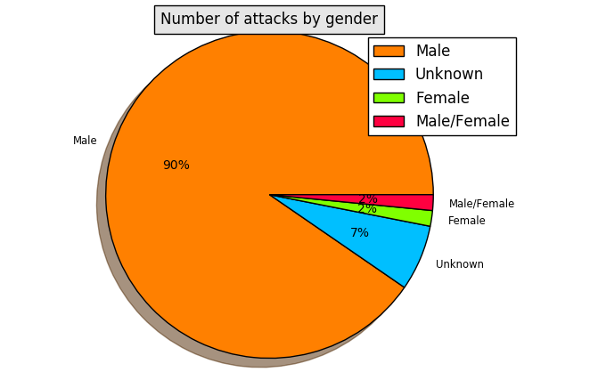
Number of Attacks by Gender
Most attacks (90%) were made by Men!

Slide 20
Conclusions & Future Work
The implementation led to interesting exploratory analysis and I got many meaningful insights from the US mass shootings data. The most interesting and important one is Mental Illness caused more attacks than Terrorism!
This proves how important it is to fix Mental Illness issue in United States.
One of the immediate future work item is to implement few more meaningful insights as follows :
Shooting Fatalities by Latitude/Longitude in United States
Another future work item could be to extend these explorations and techniques to other similar datasets for other countries / areas and publish the results, correlate them wherever applicable.

